Slide 1
Notice for the teachers
My dear colleagues, there are instructions below the slides. To make the class effective, you may follow the instructions. Remember, teacher himself is the best method.
Notes:
This is a hidden slide. Students will not see the slide.

Slide 2
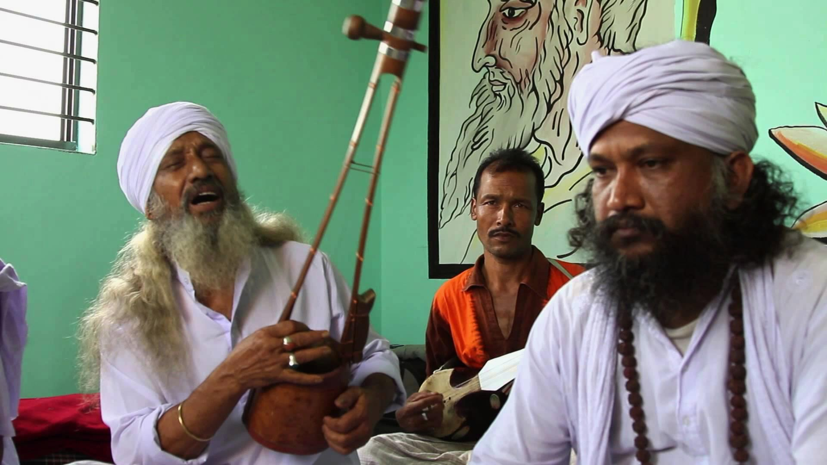
Welcome to the world of JSC Multimedia presentation
Notes:
Welcome slide to relate the students with the subject matter.

Slide 3
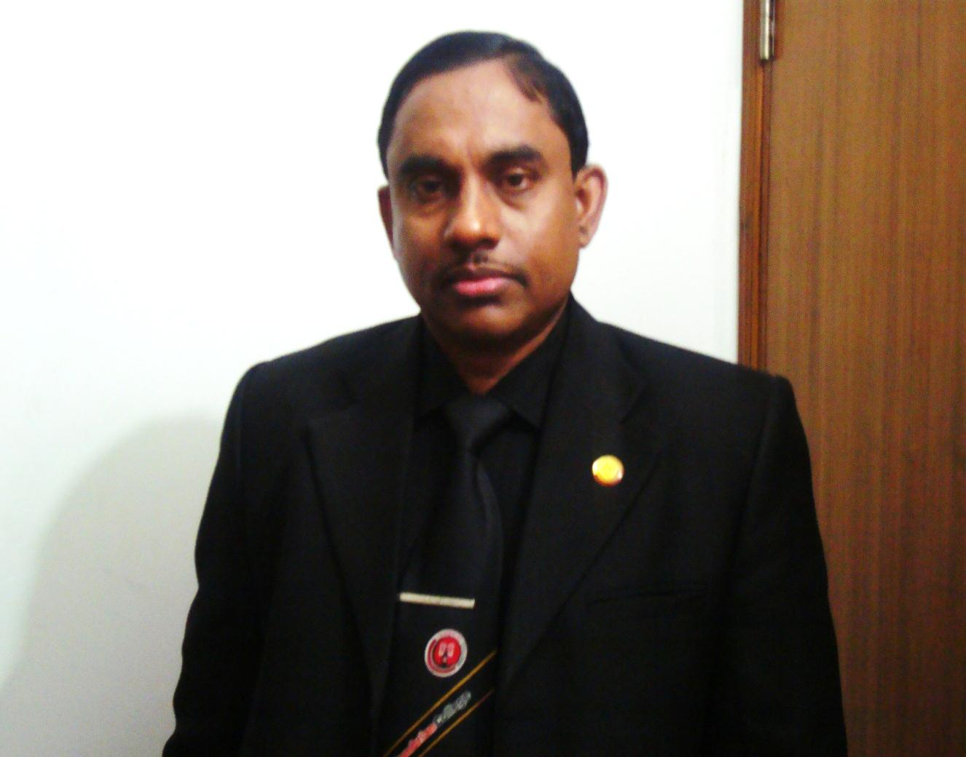
Introduction
Md Hasan Hafizur Rahman
Lecturer & Head of the Department (English)
Cambrian School & College, Campus-5, Dhaka
Class-VIII
English 1st Paper
Notes:
Introduction of the teacher & the class.

Slide 4
Let us enjoy a video
What do you mean by the video?
Folk Songs
Notes:
This video is to take out the lesson declaration from the students.

Slide 5
Our today’s Lesson is-
Our Folk Songs
Unit-1, Lesson-1
Notes:
Lesson declaration.

Slide 6
Learning outcomes
After we have studied this lesson, we will be able to---
read and understand texts through silent reading
infer meaning from the context
ask and answer questions
write answer to questions.
Notes:
Speaking, listening, reading and writing skills will be focused in this lesson.

Slide 7
Key words
Teacher may show the word first. Then he may ask the meaning of the word and at last he may show the details.
Notes:
This is a hidden slide. This option is not mandatory for the teachers. If time may cover, he may conduct this option.

Slide 8
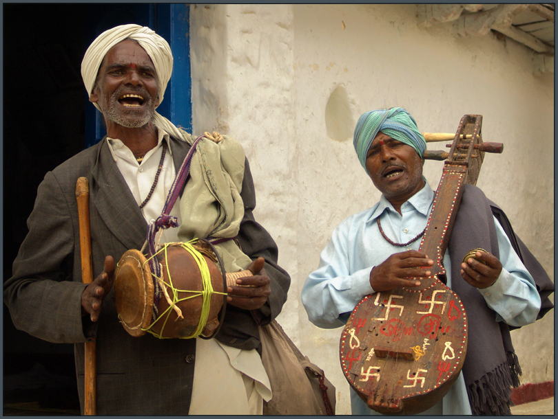
Folk
Meaning
Traditional
Folk song is a tradition of Bangladesh.
Notes:
Teacher may conduct this slide according to animation slowly.

Slide 9
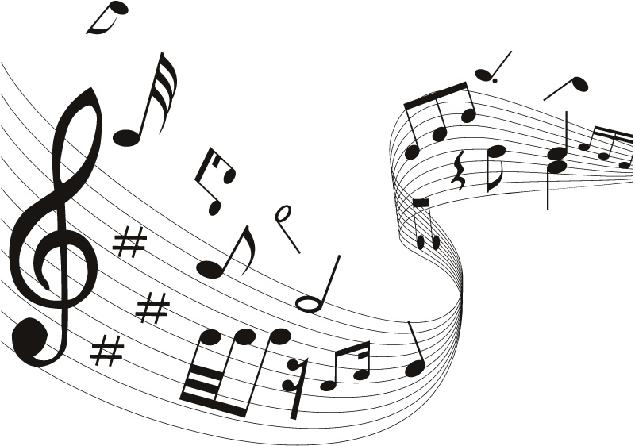
Musical
Meaning
Music related
Music becomes interesting with musical instruments.
Notes:
Teacher may conduct this slide according to animation slowly.

Slide 10

Instruments
Meaning
Music related elements
It is an art to play with musical instruments.
Notes:
Teacher may conduct this slide according to animation slowly.

Slide 11
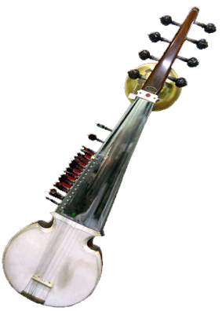
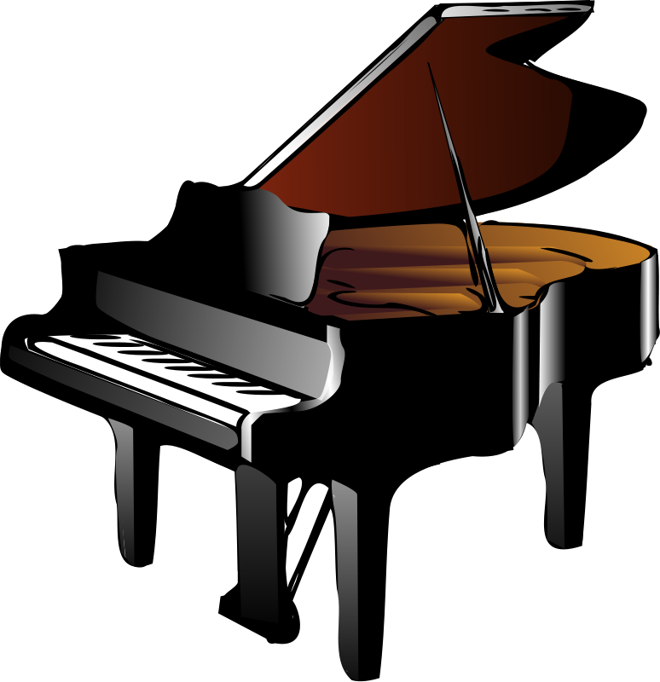
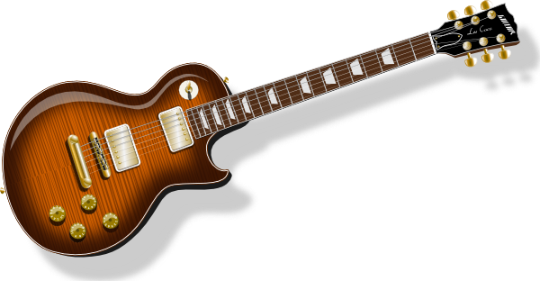
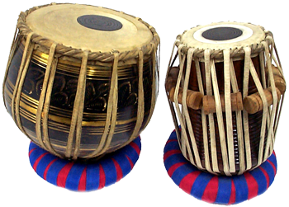
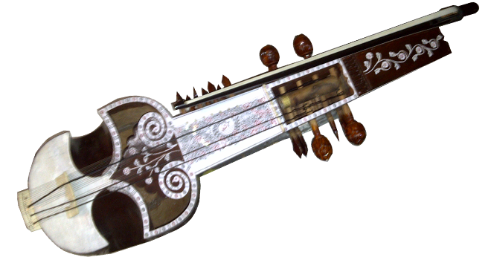
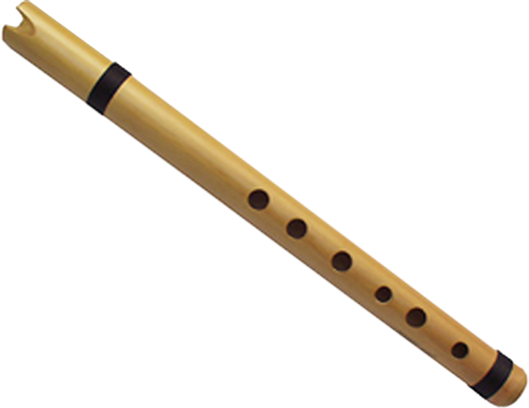
A Work in pairs. Read out the musical instruments and answer the following questions.
Dotara
Piano
Guiter
Sarinda
Bamboo flute
Tabla
Notes:
Main focusing of the text begins from here.

Slide 12
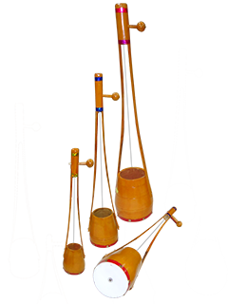
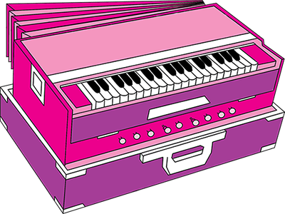
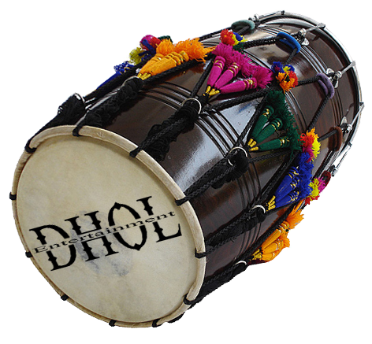
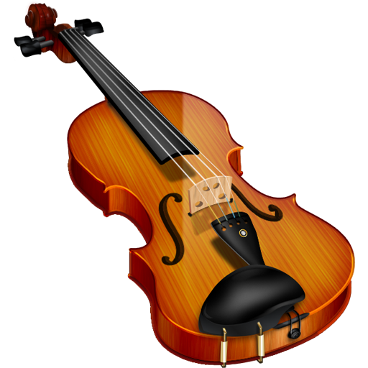
Ek-Tara
Harmonium
drum
Violin
Notes:
Description of the instruments.

Slide 13
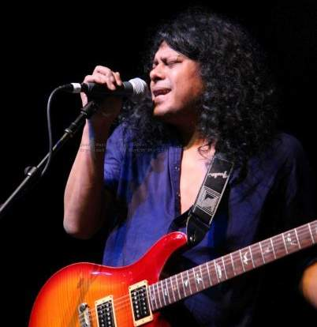
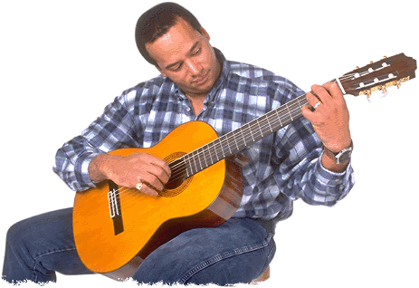
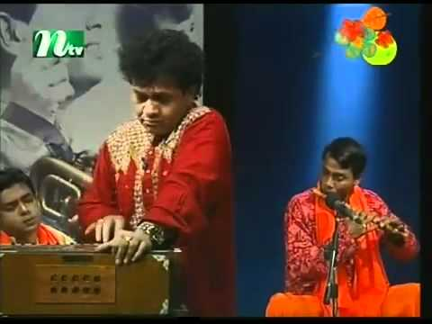
1. Can you sing a song?
2. Can you play any of these musical instruments?
3. Do you know anybody who can play any of these instruments? Tell me what you know about her/him.
Notes:
Showing the picture, teacher may ask questions to the students.

Slide 14
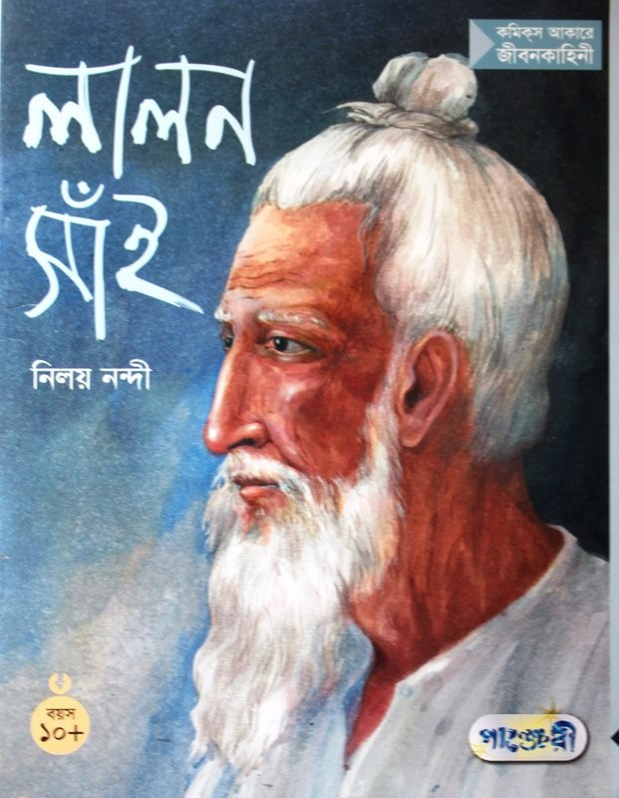
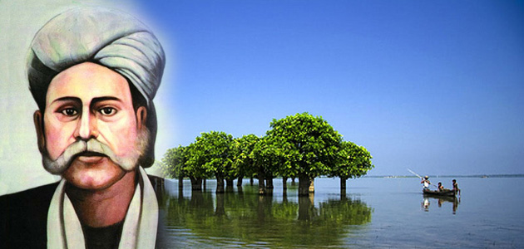
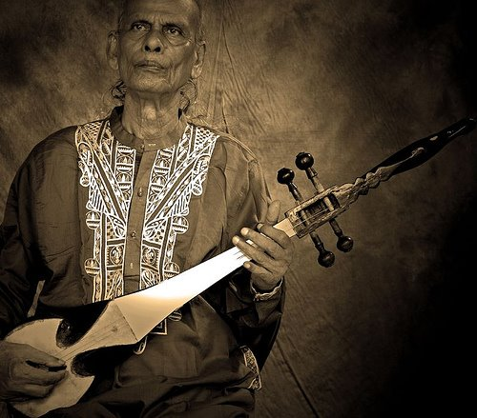
Let us introduce with some folk songs and singers.
Palligiti
Bhatiali
Bhawaiya
Palagaan
Gambhira
Lalongiti
Jari
Sari
Lalon Shah
Hason Raja
Shah Abdul Karim
Notes:
To provide information about the name of some songs and singers, It may be conducted.

Slide 15
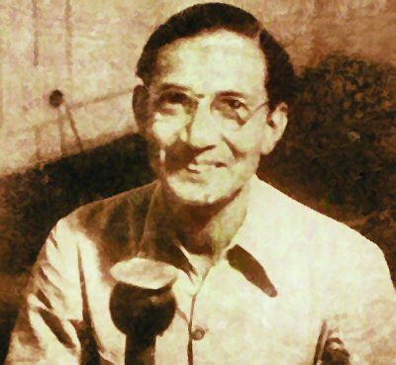
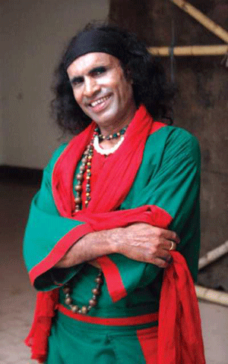
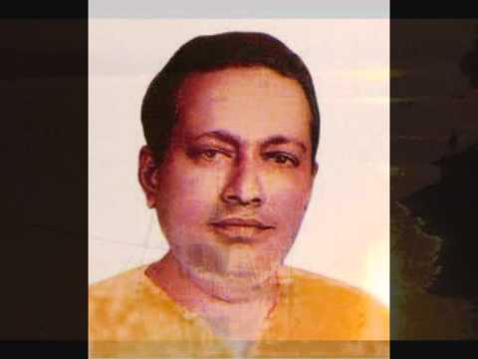
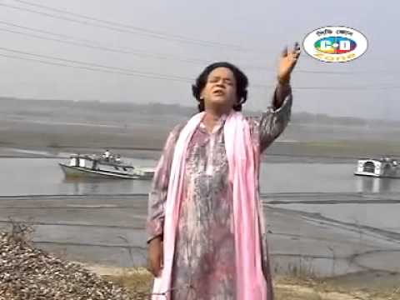
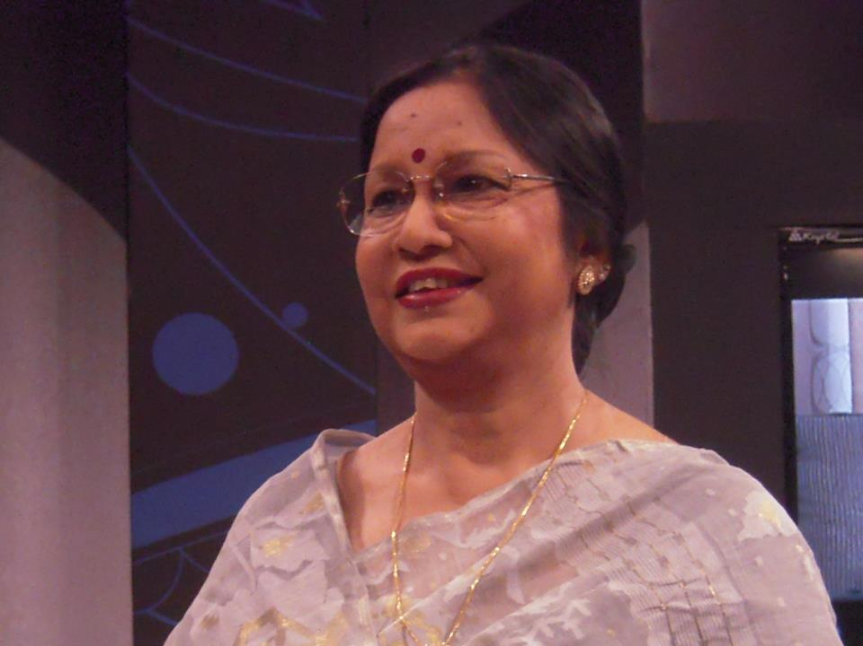
Abbas Uddin
Abdul Alim
F. Rahman
Akkas Dewan
Notes:
Former and modern folk singers.

Slide 16
B Read the text and answer the following questions.
1 Who usually likes our folk songs?
2 Can you name some well known folk singers?
3 Do you like folk songs? If you do, who is your favourite folk singer?
Which song or songs do you like most?
4 Look at the musical instruments in A above and say which instruments go well with the folk songs.
Notes:
Evaluation option.

Slide 17
Group Works
C Discuss in groups and write a paragraph on the following question.
Do you want more or less programmes on folk songs on our TV channels? Why?
Notes:
Free hand writing skills may be introduced.

Slide 18
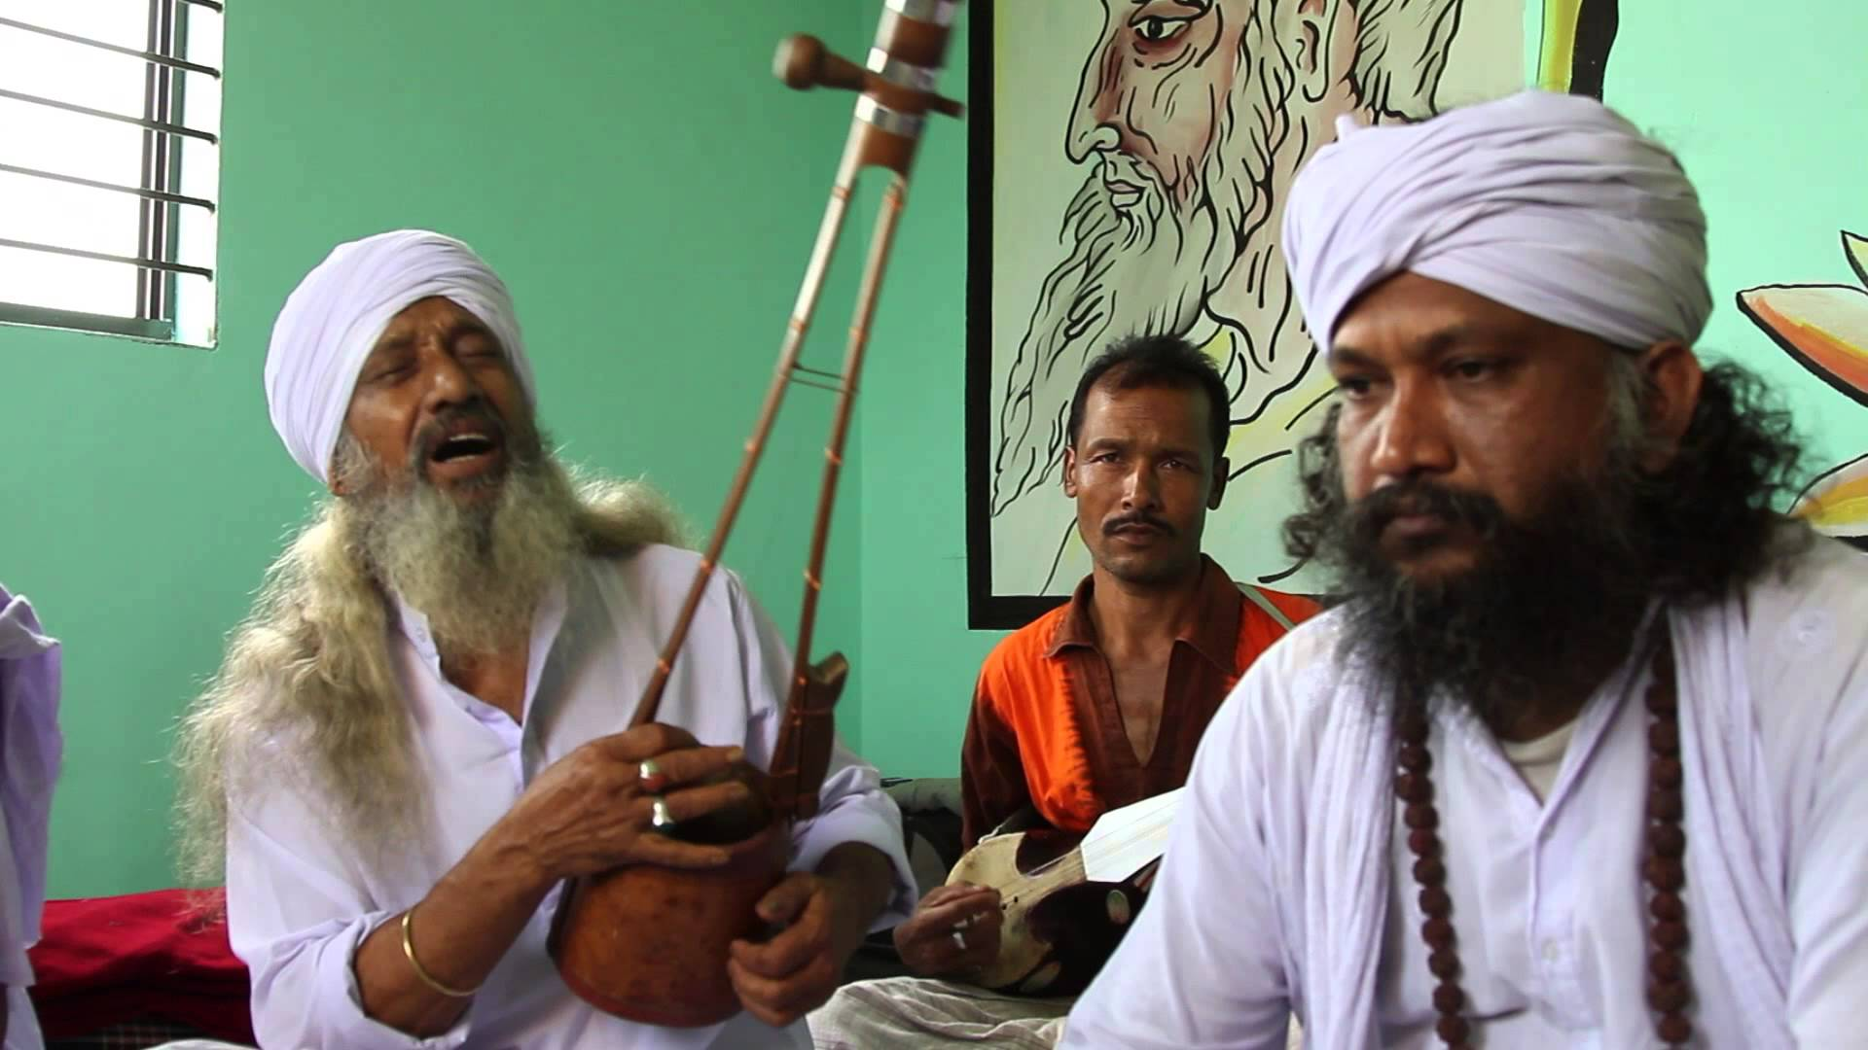
See You again in the next class.
Notes:
Ending greetings.

Slide 19
Acknowledgement
We would like to express our cordial gratitude to the Ministry of Education, Directorate of Secondary & Higher Education, NCTB, A2i and the panel of honorable editors ( Md. Jahangir Hasan, Assistant Professor (English) TTC, Rangpur, Ranjit Poddar, Associate Professor (English) TTC, Dhaka, and Urmila Khaled, Assistant Professor (English) TTC, Dhaka, to enrich the contents.

